Slide 1



Bodega Vistalba
Recommendations for Visitor Experience
Tess Kamauff,
Eric MacBlane,
Morgan Sasser,
Emmett Saulnier,
Bill Su

Slide 2
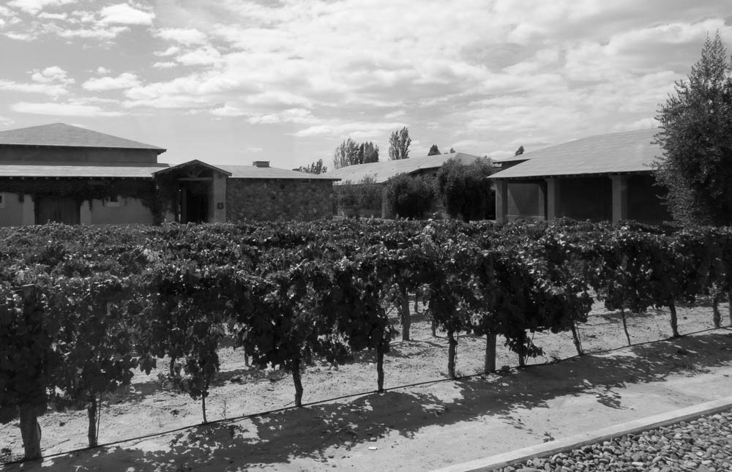
Executive Summary
Use signs to direct customers

Slide 3
Executive Summary
Increase consumer knowledge

Slide 4
Executive Summary
Make tour script unique

Slide 5
Executive Summary
Optimize checkout with two people

Slide 6


Slide 7
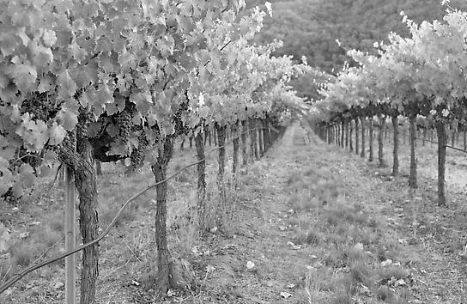

Vistalba logo will improve brand exposure

Slide 8
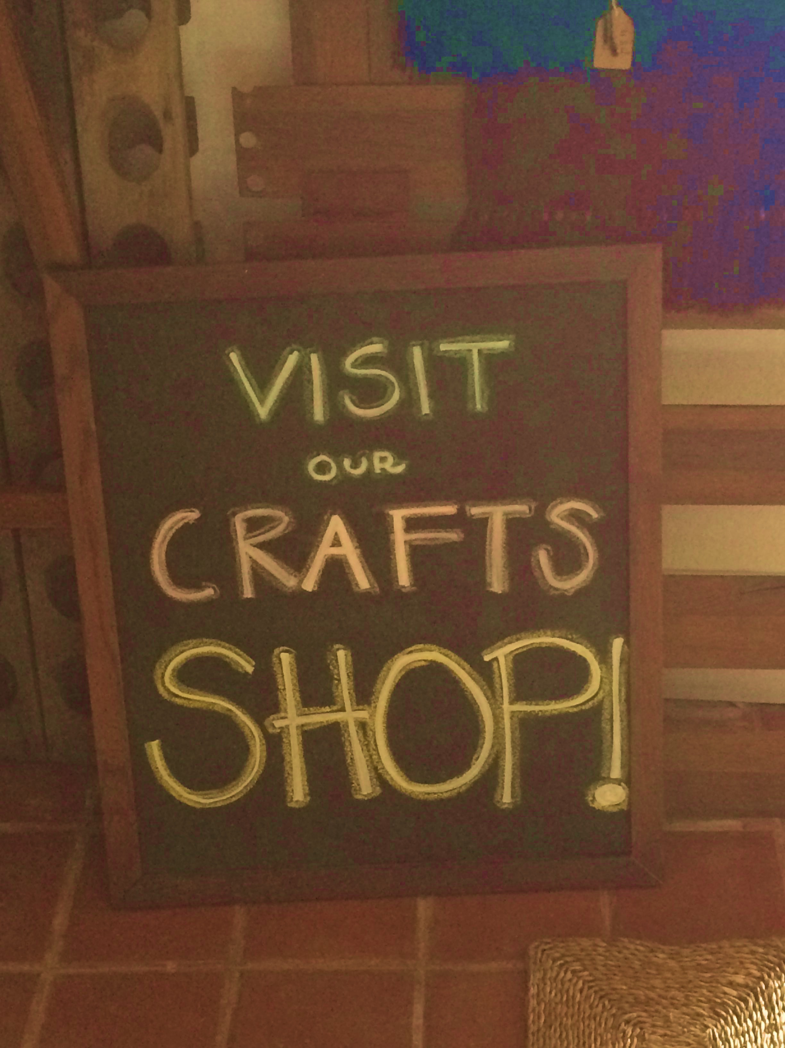
Chalkboard will navigate customers to gift shop

Slide 10
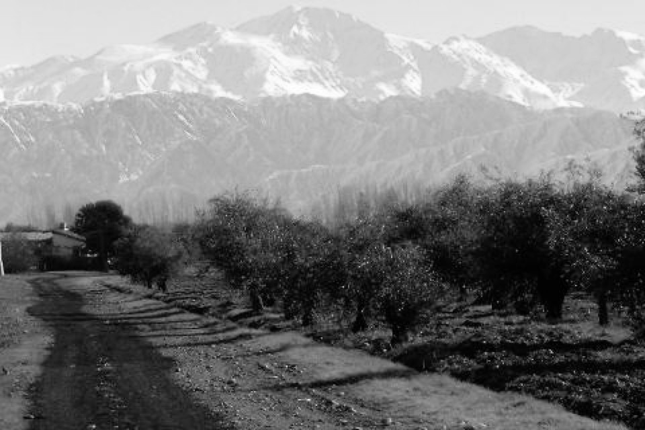
Checkout time is optimized with two staff members
36% Decrease
Notes:
Based on the problem statement we received, our first check was looking into the checkout process to examine backlogging
We worked with the staff to compile a process flow, that we used to simulate the checkout process after 100 “example tours”
These simulations allowed us to estimate the impact of various levels of staff at checkout
We realized:
(1) With two staff, checkout was 36% than with one staff member
(2) Additional staff after 2 did not change anything
(3) Checkout did not seem to be a significant time constraint (i.e., 2-3 minutes)

Slide 11
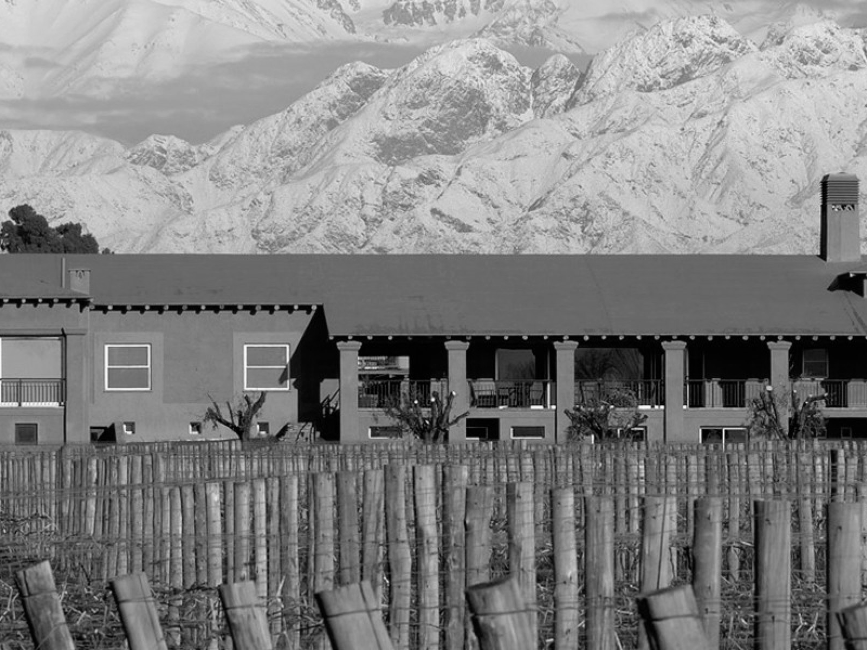
Tour guides spend little time checking out visitors
Tour Guide Time Use
Guiding
(4%)
Notes:
To reinforce our suspicion about a lack of a constraint in the checkout process, we tracked the utilization of tour guides over the course of a day
Only 4% of a tour guide’s time was spent on checkout, demonstrating low resource utilization in that area
With these two findings, we advise that the checkout process remains as is: one person in general, and two people after a tour

Slide 12
Test recommendations to determine effectiveness
1
Control Group
For current operations

Slide 13
Test recommendations to determine effectiveness
Treatment Group
For implementation analysis
2

Slide 14
Test recommendations to determine effectiveness
3
Decision
Constructed on simple analysis

Slide 15

Break-even time is low for each change
7.2
4.5
2.0
N/A
0.2
N/A
Notes:
Shows revenue increase as % versus payoff time in months; payoff time overall is low, and ultimately will increase annual revenue by $140,000

Slide 16
Two people at checkout will
Decrease wait time by
36%

Slide 17
Adding deliberate signage will
Increase revenue by
3%

Slide 18
Increasing consumer knowledge will
Increase revenue by
6%

Slide 19
Changing
scripts will
Increase revenue by
5%

Slide 20
14%
Increase in Gift Shop Revenue
$140,000
Annually

Slide 21
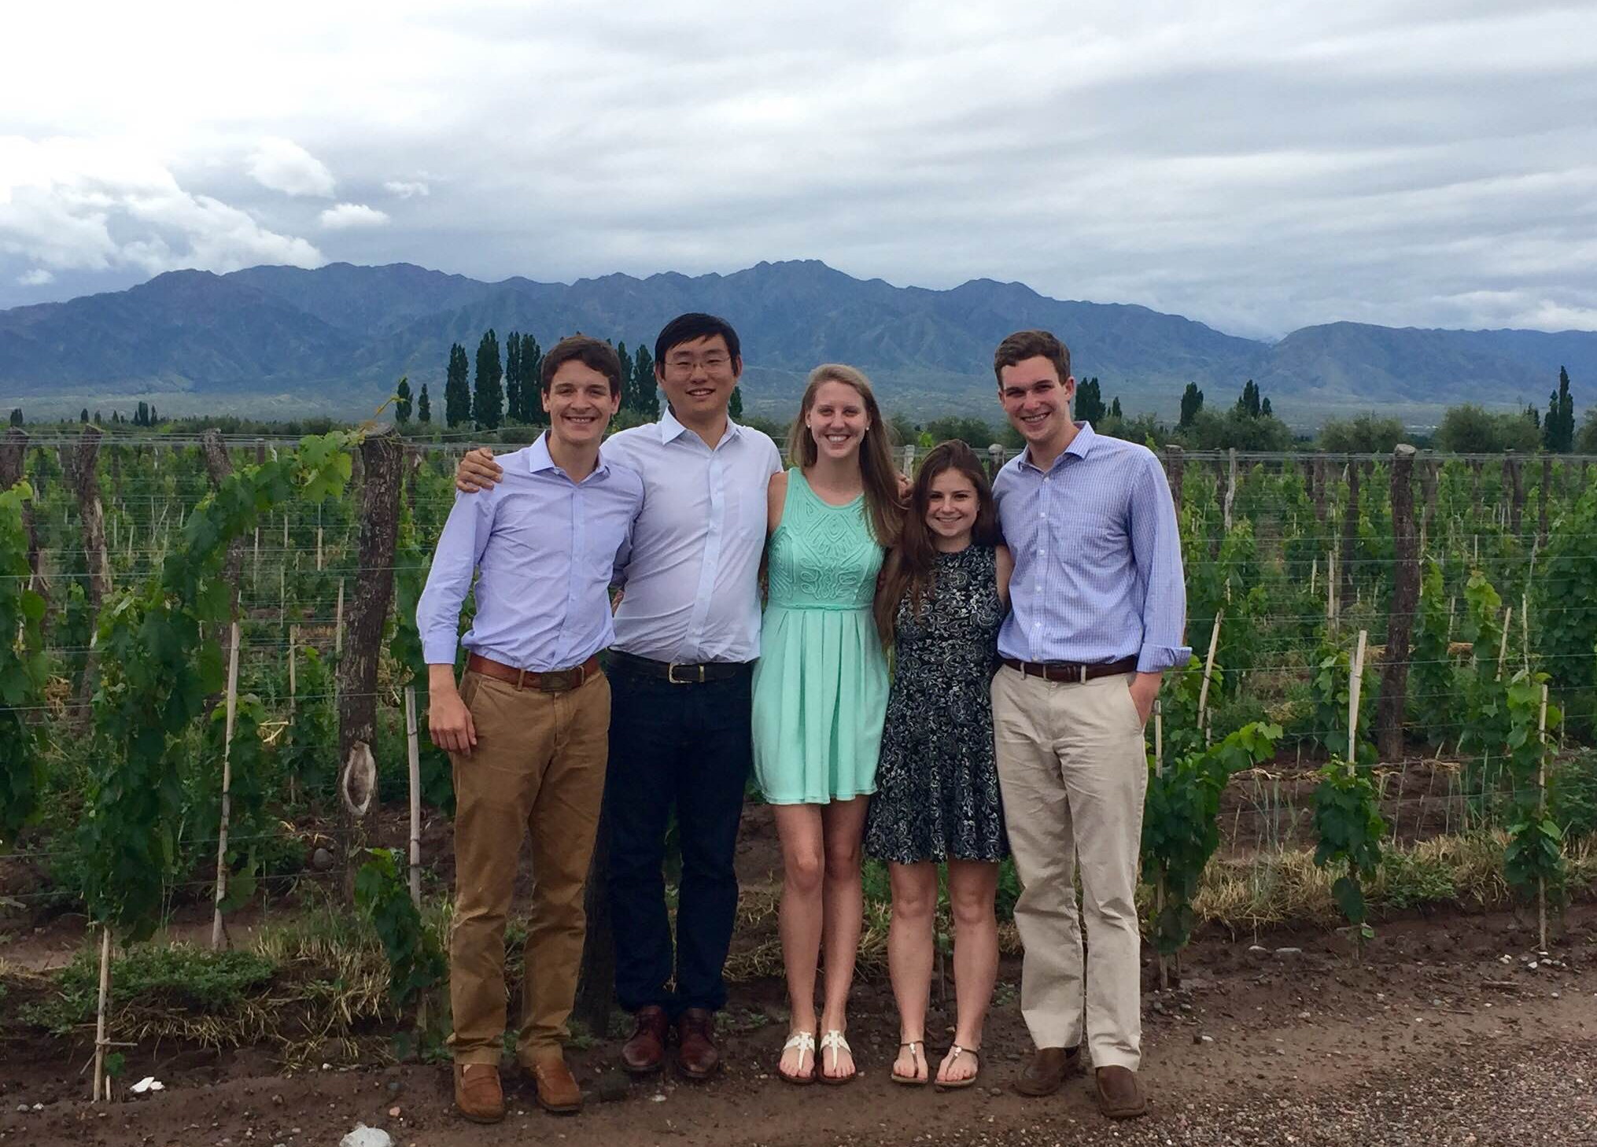
Thank You!
Questions?

